Slide 1
PYTHON COMMAND AND SYNTAX CHEATSHEET
You can take this into the openbook exam
Printing and f-strings
Print a string | print("bird") print('eagle')
Print a variable's value | animal = 'bird' name = 'eagle' print(animal, name)
Print with an f-string | print( f'An {name} is a {animal}' )
Print a number to 2dp | x = 3.1428 print( f'value of x = {x:.2f}' )
Arithmetic
Addition | a + b
Subtraction | a - b
Multiplication | a * b
Division | a / b
Exponent | a**b
Increment | a = a + b a += b
Single or double quotes are ok
Remember the f before the quote and the curly brackets
These both increment a by b
Lists and loops
Create a list | names = ['eagle', 'pigeon']
Number of elements | len( names )
Access 2nd element | print( names[1] )
Loop through a list | for s in names: print( s ) print( 'finished' )
Don't forget the square brackets
Conditional statements (if, else)
if x > 7: print( 'x is greater than 7' ) else: print( 'x is less than or equal to 7' )
test if x is in a range | if 3 <= x <= 7:
test if x is outside of a range | if x < 3 or x > 7:
Is equal to | ==
Is not equal to | !=
Is greater than | >
Is less than | <
Is greater than or equal to | >=
Is less than or equal to | <=
Indexing starts from zero
Don't forget the colons or the indentations
Don't forget the colon.
Only indented code is in the loop.
Importing modules
Mathematical functions | import math
Data analysis tools | import pandas as pd
Data visualisation | import seaborn as sns
Math functions on DataFrames | import numpy as np
Import specific functions | from scipy.stats import ttest_ind
Double equals for conditions, single for assignment
Reading files into DataFrames
csv files | birds = pd.read_csv( 'birds.csv' )
Excel files | birds = pd.read_excel( 'birds.xlsx' )
Other plots
Box plot | g = sns.catplot( data=birds, kind='box' )
Swarm plot | g = sns.catplot( data=birds, kind='swarm')
Strip plot | g = sns.catplot( data=birds, kind='strip' )
Printing DataFrames
Whole dataframe | print( birds )
A single column | print( birds['eagles'] )
Saving a graph
sns.savefig( 'birds.jpg' )
Histograms (frequency distributions)
Each and every column in a single graph | g = sns.displot( birds )
A single column | g = sns.displot( birds['eagle'] )
Relative frequency | g = sns.displot( birds['eagle'], stat='proportion' )
Descriptive statistics of a sample
Mean of each column | xbar = birds.mean()
St. dev. of each column | s = birds.std()
Sample size of each column | n = birds.count()
Mean of one column | xbar = birds['eagle'].mean()
St. dev. of one columns | s = birds['eagle'].std()
Sample size of one column | n = birds['eagle'].count()
Annotations
x-axis label | g.ax.set_xlabel( 'size' )
y-axis label | g.ax.set_ylabel( 'number of birds' )
Graph title | g.ax.set_title( 'distribution of bird sizes' )
Legend title | g.legend.set_title( 'bird species' )
Two sample t-test
t, p = ttest_ind( birds['eagle'], birds['pigeon'], nan_policy='omit' )

Slide 2
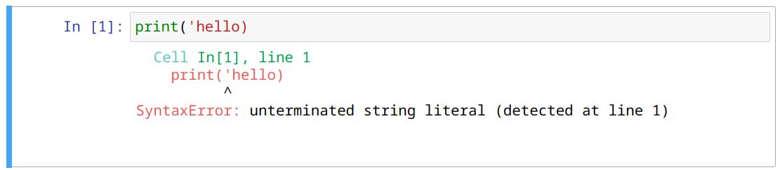
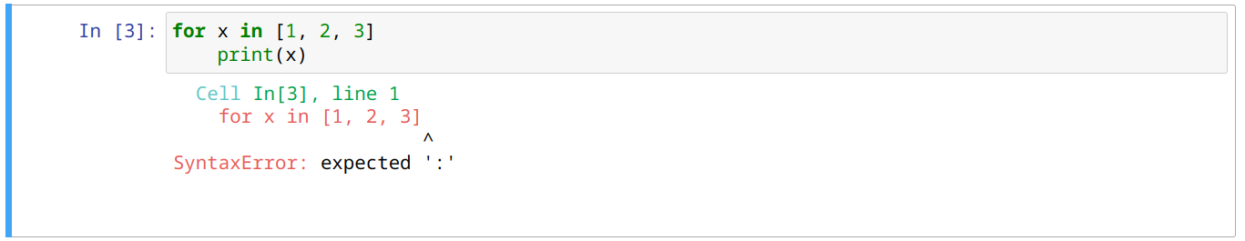
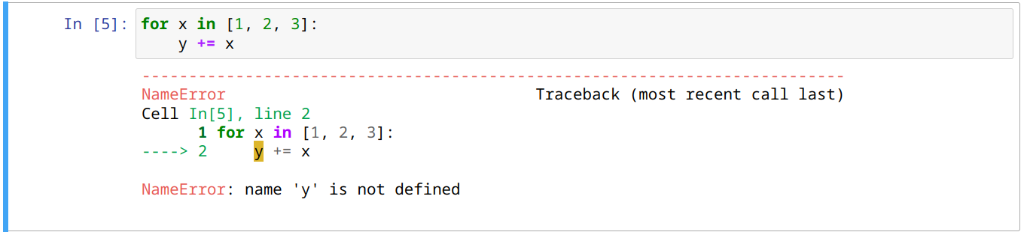
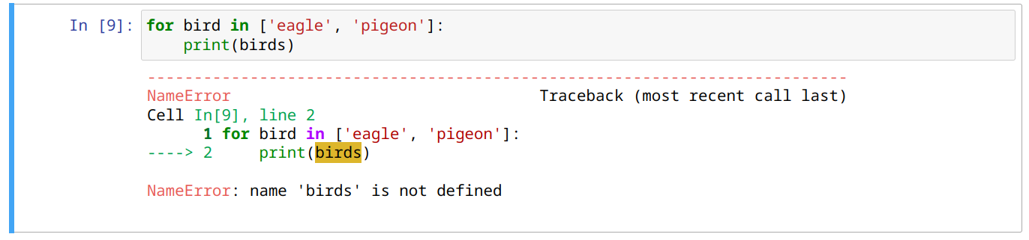
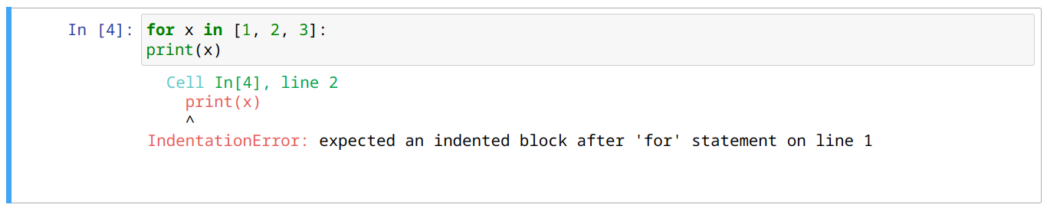
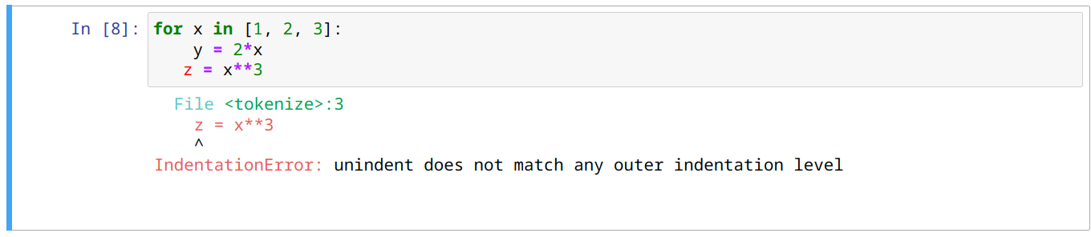
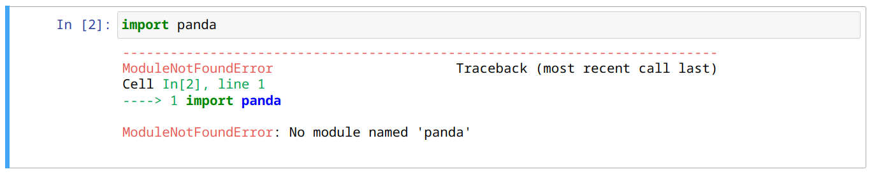
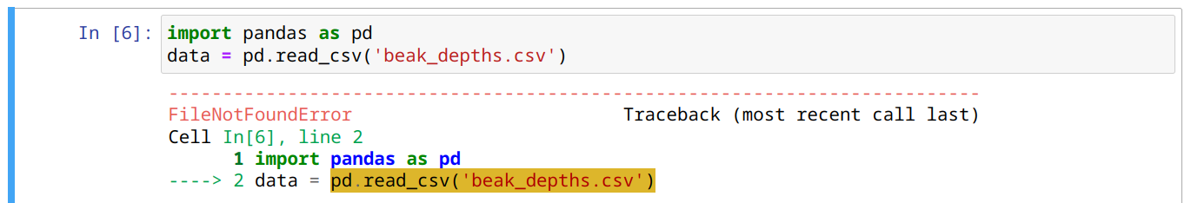
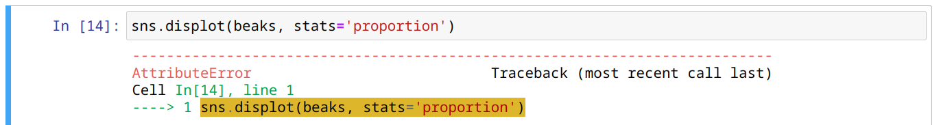
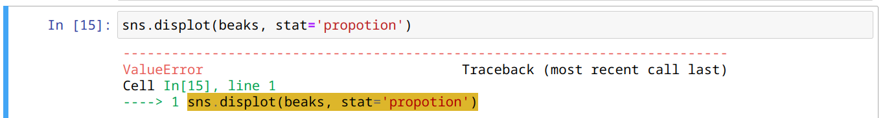

PYTHON ERROR-MESSAGE CHEATSHEET
You can take this into the openbook exam
Three things to look for when an error occurs
Most errors are misspellings of variable names and DataFrame column names. Check your spelling very carefully
2. ^ shows the code that caused the error
1. Error occurred on line 1
3. The type of error
Below are some of the types of errors you will encounter and some of the reasons for them. Example code to the left reproduces common errors.
SyntaxError:
Usually a missing colon, parenthesis, square and curly bracket or comma.
Missing in in the for-loop.
NameError:
A variable has been used in a calculation before it has been initialised. Here x is added to y, but y has not been set to some value beforehand.
A misspelt variable. Here birds should be bird.
A misspelt function name, such as Print() with a capital P
IndentationError:
Forgot to indent code after a for-loop, an if or else statement.
When indented code does not align properly. Here z = x**3 does not align correctly with y = 2*x
ModuleNotFoundError:
Misspelt module name; should be pandas
Pandas errors messages can be very long. Just look down the error message for the type of error and the line of code causing it
FileNotFoundError:
Misspelt file name; check for plurals, underscore characters.
File is not in the same directory as the notebook. To correct, add the folder name, such as Datasets/beak_depths.csv
AttributeError:
Misspelt keyword in a function. Here stats should be stat.
ValueError:
Misspelt keyword value in a function. Here 'propotion' should be 'proportion'.
KeyError:
Misspelt column name in a DataFrame. Here '1977' should be '1976'. You may need to scroll down to find the offending line and code.

Slide 3
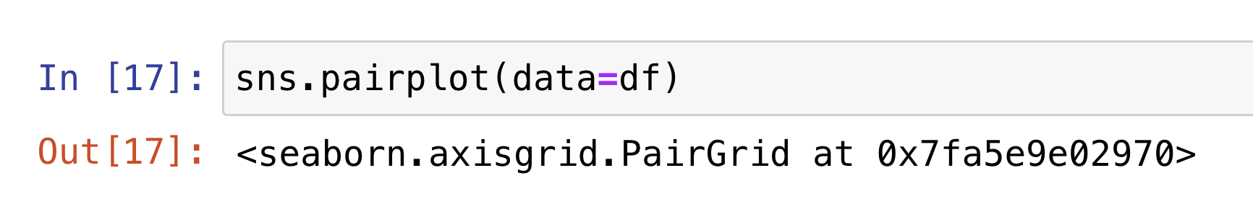
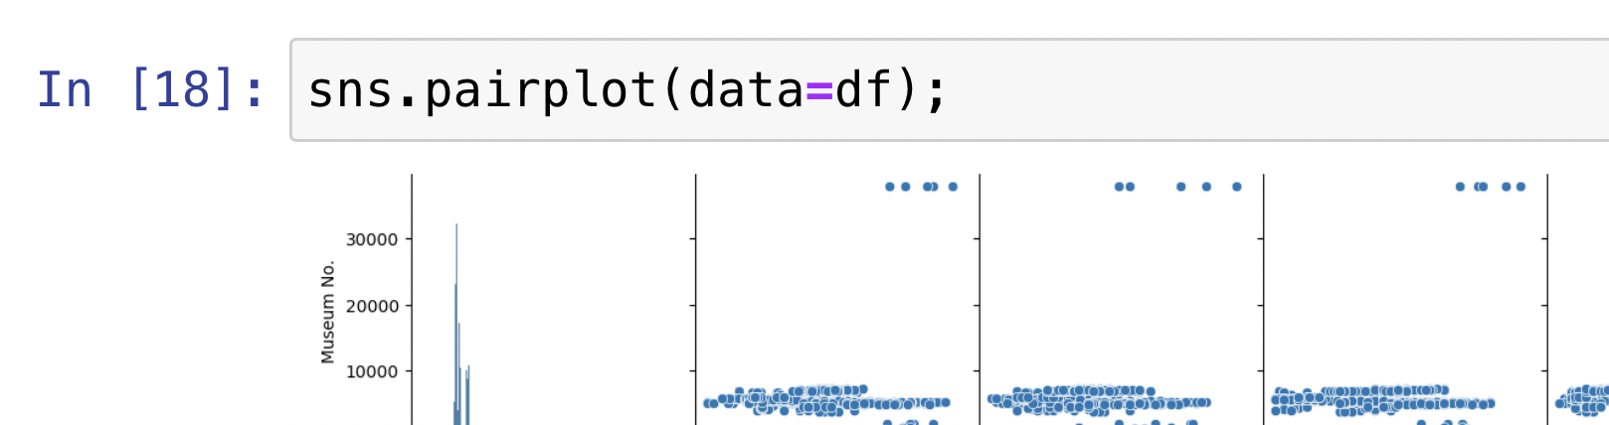
Add your own notes here.
(Examples of common plotting issues)
My plot doesn’t appear
Run matplotlib inline
I have a code at the top of my plot
Add a “;”
It won’t plot what I want!
ValueError: The following variable cannot be assigned with wide-form data: `hue`
Make the df long form using melt
All I see is warnings
warnings.warn(msg, UserWarning)
Advice about changes coming, or poor use of commands.
If you don't want to take it, can be turned off with:
import warnings
warnings.filterwarnings('ignore')
Don't forget to switch them back on:
warnings.filterwarnings('always')

